Slide 1
GATE Parent Advisory Committee
Meeting #1
Edison Academy
Wednesday - August 23, 2023
Presented by:
Dawn Swanson Mauricio Gormaz
Assistant Principal Principal
Tami Emerson Michael Bui
1st Grade Teacher Middle School Teacher - 6th grade

Slide 2
WELCOME EDISON
PARENTS !!!
Spanish Translation is available

Slide 3
Why do we need a GATE Parent Advisory Committee?
Gifted students represent a vital resource that has unlimited potential.
We need to make sure that these exceptional young people have the support and services they need to be successful.”
- Senator, Chuck Grassley

Slide 4
Agenda
Title 1 Presentation - Mrs. Swanson
GATE Program Expansion - Mr. Gormaz
“GATE Thinking Prompts” - Mrs. Emerson (1st grade teacher)
“Spiraling -From Simple to Complex” Mr.Bui (6th grade teacher)
Elect OMSD GATE Representative (Parents)
Questions & Answers

Slide 5
Title I Annual Meeting
Supporting Your Child to Achieve
Ontario-Montclair School District

Slide 6
What are Title I Funds Designated For?
Title I provides federal aid to districts and local schools.
Title I funds are allocated to schools to support children from low-income families.
All OMSD schools are considered Title I
Notes:
Title 1 funds are federal funds schools receive to support children from low income families. All OMSD schools are Title.

Slide 7
Title I Requirements
Schools must annually update their Parent Involvement Policy jointly with their parents.
Schools must develop, with parents, their School-Parent Compact at least every other year.
Schools must hold a flexible number of meetings to inform parents of Title I requirements and of their right to be involved.
Schools must distribute the policy and compact to all parents.
Notes:
We work on our PIP and Compact with SSC and updated it at the end of last year. We will distribute the final copy to parents this year. Our Parent meetings are flexible in that they are conducted in person and via zoom at different times of day. and we are being informed of your rights today - this presentation is shared at all the Parent Advisory meetings

Slide 8
Title I Requirements
Schools must involve parents on ongoing basis in the planning, reviewing and improvement of its Title I programs including parent participation in the Single Plan for Student Achievement (SPSA).
Offer a flexible number of meetings,
Inform parents of an explanation of the curriculum, academic assessment used to monitor student growth, and academic proficiency levels students are expected to meet.
Notes:
Parent Advisory Groups are able to discuss needs and make recommendations to the SSC for consideration in the school plan.

Slide 9
Parent Involvement Funding–1%
1% of Title I funds is designated for parent involvement activities including promoting how parents can support their child to achieve.
Notes:
Flyers - Building Self Efficacy at home, Social Media-Safety and Awareness - put link in chat with flyers

Slide 10
School-Parent Involvement Policy Parent Compact
The parent involvement policy describes how parents can be involved in a meaningful way, be in a language and format in which parents can understand, help build capacity of parents, have a parent compact component, be reviewed and updated annually.
Notes:
PIP outlines the rights of parents to be involved - and the compact talks about what the school, parents and students will do to support success, health and wellness of students.

Slide 11
Parent Involvement to Support Student Achievement
Topics such as academic standards, state and local assessments, how to monitor a child’s progress and work with educators to improve achievement of their child.
Materials and training to help parents work with their children to improve achievement
Teacher and staff training on value and contribution of parents, how to communicate and work with parents as equal partners.
Notes:
Parents learn about the what students will be taught, how they will be graded and what they can do to help their students. There are parent workshops to guide you in helping your child. Teachers and staff value the role parents play in the success of students and the school.

Slide 12
Parent Involvement to Support Student Achievement
Provide information related to school and parent programs, meetings and other activities
Ensure informed participation of parents and family
Ensure two-way communication such as parent-teacher conferences, reports to parents, reasonable access to staff and opportunities to participate in their child’s education

Slide 13
Ways Parents can become involved in supporting decisions at our school
School Site Council
School English Learner Parent Advisory Committee
Gifted and Talented Education Parent Advisory Committee
Special Education Parent Advisory Committee
Parent Volunteer
Coffee with the Principal
PFO -Parent Faculty Organization
Notes:
You will be making the decision today to choose a representative to attend district GATE meetings and share them with the group at the next 2 meetings.

Slide 14
Some Ways we
Measuring Academic Progress
As a school site, we will use the following metrics:
English Language Proficiency Assessment for California (ELPAC)
i-Ready Benchmark Assessment (1st-8th)
ESGI (K)
California Dashboard Suspension and Chronic Absenteeism Rates
District Attendance Rates
Smarter Balanced Assessments in ELA and Math
Reclassification Rates

Slide 15
Proficiency Levels Students Expected to Meet
We will be working this year with you to help understand the 4 levels of proficiency and what growth they need to make to make grade level growth.

Slide 16
Four Levels of CAASPP

Slide 17
Overall Scores – 2 Subjects, 4 Levels
English Language Arts/Literacy – Mathematics
Standard Exceeded (Level 4)
Standard Met (Level 3)
Standard Nearly Met (Level 2)
Standard Not Met (Level 1)
Notes:
Overall Score and Achievement Level
For each grade level and subject area, students receive a score from approximately 2000
to 3000. The overall score falls into one of four achievement levels:
l Standard Exceeded: The student has exceeded the achievement standard and
demonstrates advanced progress toward mastery of the knowledge and skills needed
for likely success in future coursework.
l Standard Met: The student has met the achievement standard and demonstrates
progress toward mastery of the knowledge and skills needed for likely success in
future coursework.
l Standard Nearly Met: The student has nearly met the achievement standard and may
require further development to demonstrate the knowledge and skills needed for likely
success in future coursework.
l Standard Not Met: The student has not met the achievement standard and needs
substantial improvement to demonstrate the knowledge and skills needed for likely
success in future coursework.

Slide 18
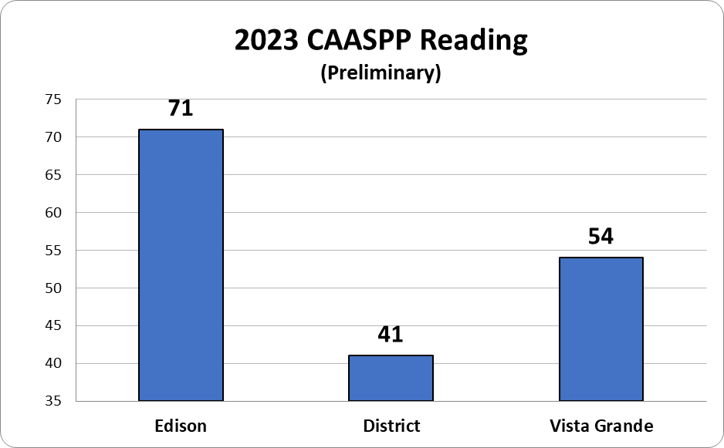
CAASPP: Schoolwide Results
Notes:
Renee

Slide 19
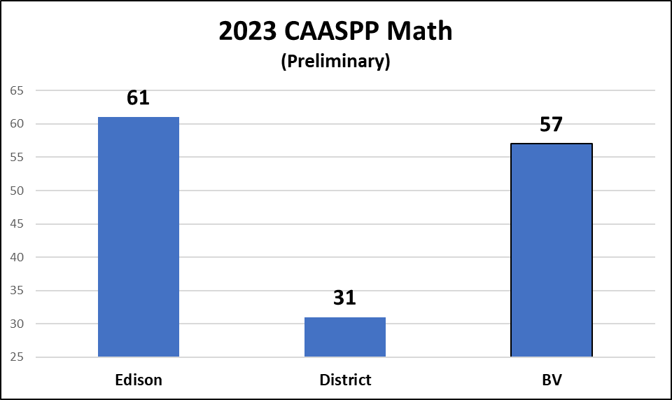
CAASPP: Schoolwide Results
Notes:
Renee

Slide 20
Other Ways Parents can support their child’s education at Edison
Parent Conferences (Nov. 13-17 & March 18-22)
Open House (April 18, 2024)
See Handouts for:
Parent Workshops, Coffee with Principal, Family Nights, Parent Volunteer Orientation

Slide 21
Edison Academy of Differentiated Learning
GATE Magnet
Sometimes You, Sometimes Me, Always Us
GATE, Intervention, ELOP, Speech, RSP
California Pivotal Practice, Title 1 Achievement, Gold Ribbon PBIS Gold, Community Cares Awards

Slide 22
Intervention Supports at Our School
For Struggling students:
Best 1st instruction, small groups, UA, intervention
For English learners:
Best first instruction, ELD in class supports, newcomer TOA
For Special Education:
Best First instruction, small groups, RSP, Speech, OT

Slide 23
Required Title I Notices
Each year, the district and schools have to notify parents, in a language and format they can understand (whenever possible), about the following:
School Progress (SARC)
Title I Services
Parent Involvement Policy
Agreement between the school and parents (compact)
Title I English learner parent initial and annual notification letters.
Keep an eye out for these documents and information for 2023-2024
Notes:
School Accountability Report Card - Demographics, location description of facility, teacher qualifications - everything about the school

Slide 24
ANY QUESTIONS?

Slide 26
GATE Expansion at Edison
Foster the development of critical thinking through the use of Depth and Complexity Prompts in ALL classes
GATE clusters and differentiation is key
Increase in GATE qualified students
Notes:
Mauricio

Slide 27
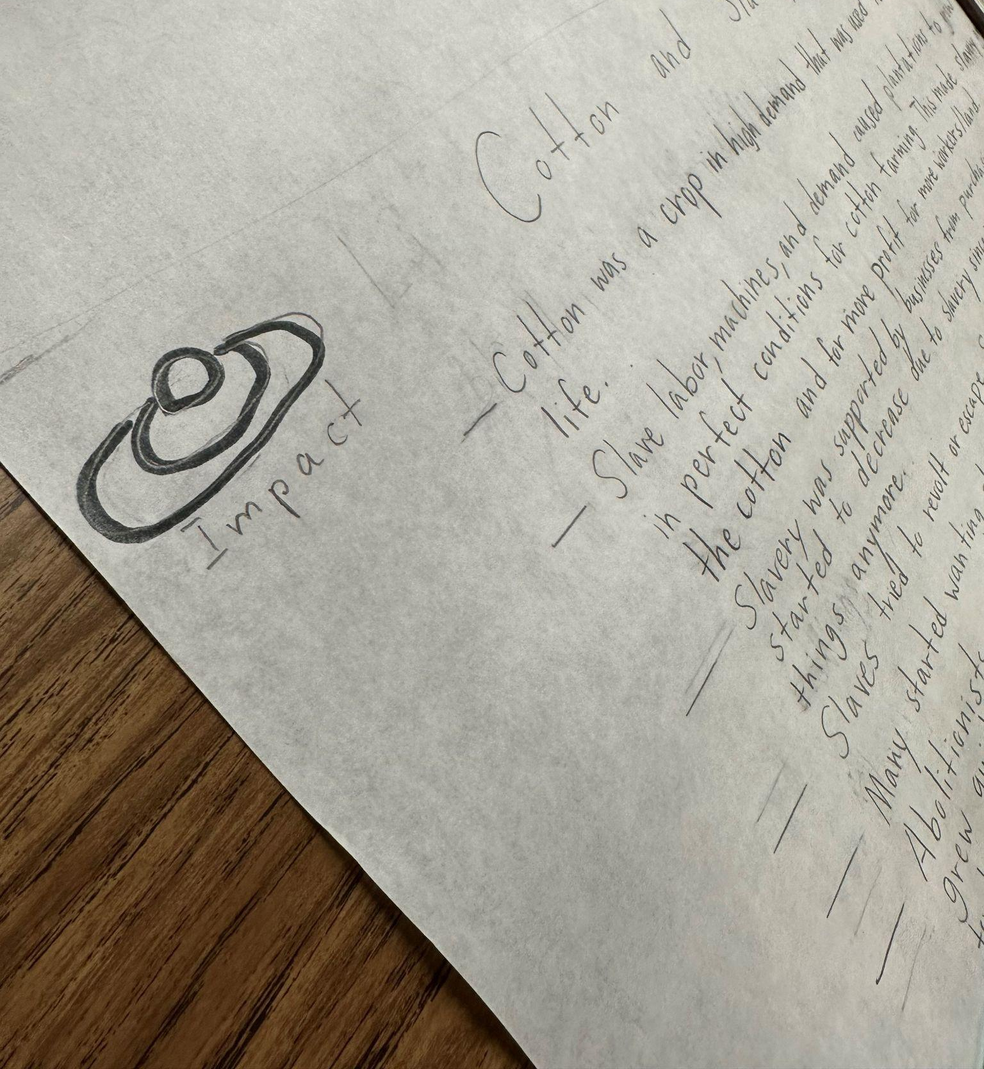
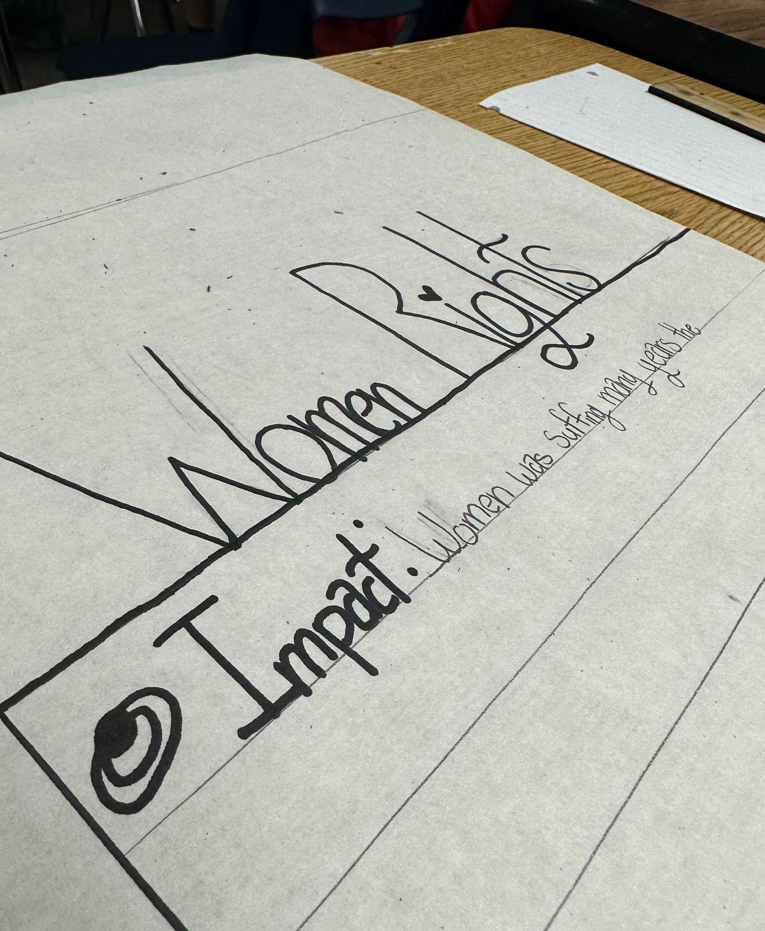
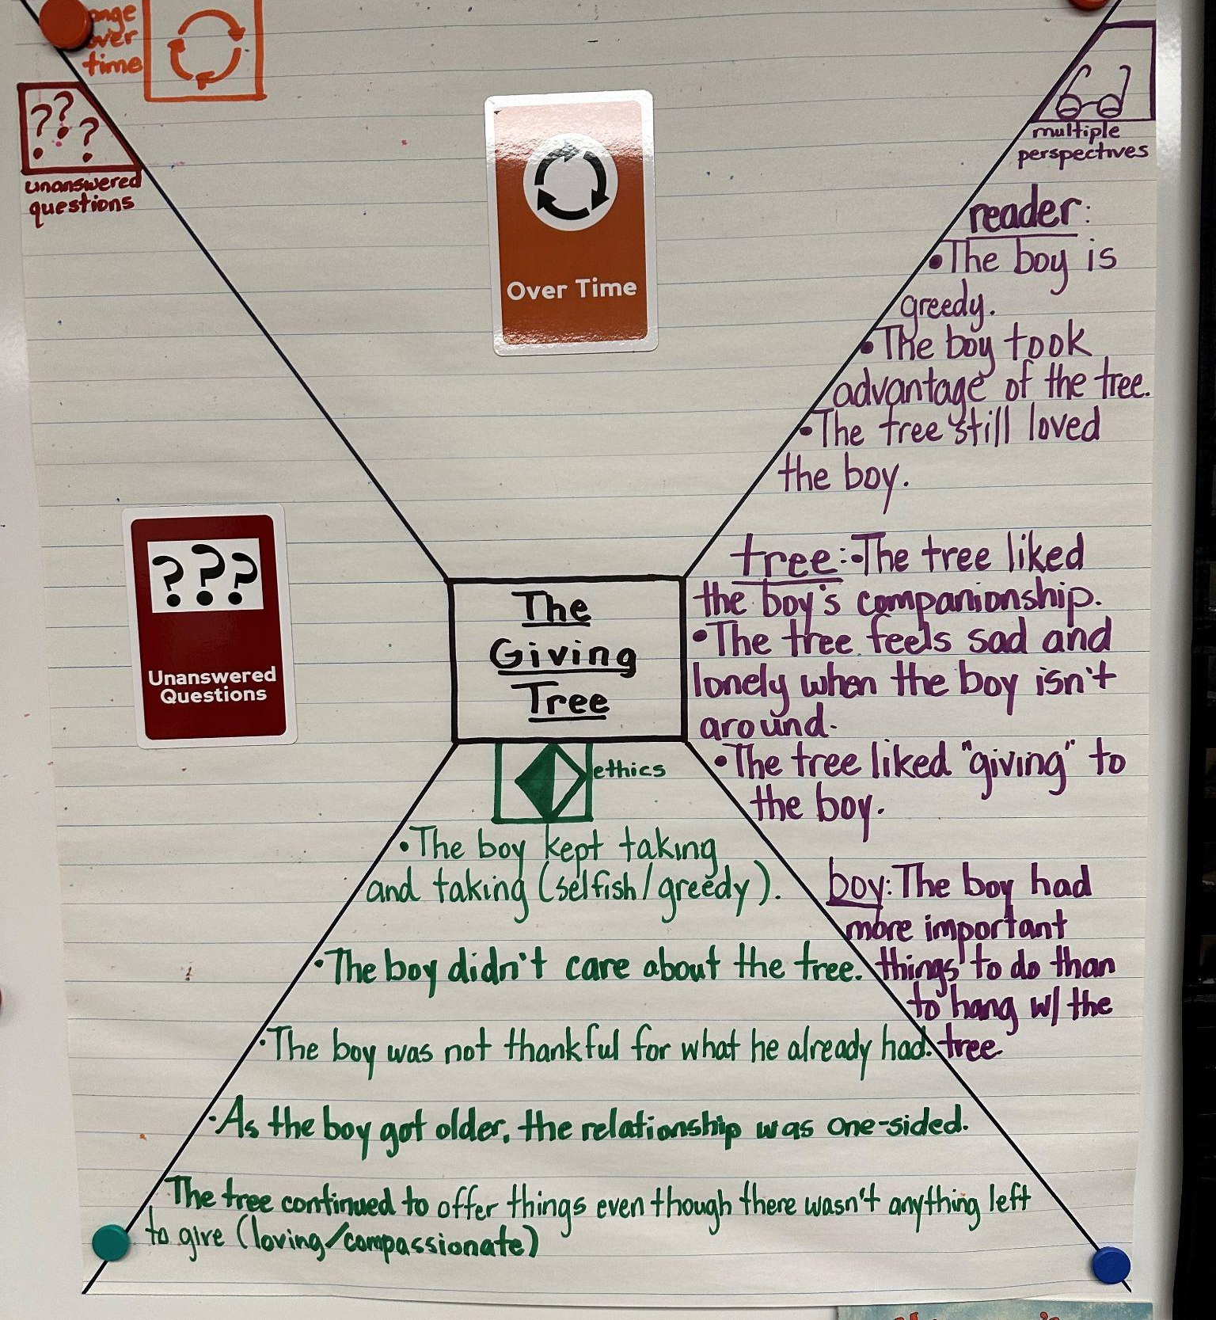
GATE Expansion at Edison
GATE Program at Edison is Expanding
4 Heterogenous 3rd grade classes
1 Self Contained 4th grade
3 Heterogenous 5th grades
3 Heterogenous 6th grades
All of Middle School - 7th & 8th
There are more students in our program and we are able to service them because EVERY teacher is GATE Certified and able to Differentiate for the needs of all students.
Differentiation/MTSS
Best First Instruction - Tier 1
Small Groups -Tier 2
UA-Universal Access-Tier 2
Intervention - Tier 2
RSP/one-on-one - Tier 3
Notes:
Mauricio

Slide 28
GATE strategies are also for primary students!
They are used to…
To create lifelong learners.
To create lifelong learners who can think deeply about themselves and their world.
To create lifelong learners who can think deeply about themselves and their world in order to make an impact on those around them
Notes:
Tami Emerson - INTRODUCTION

Slide 29
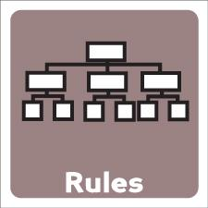
Depth & Complexity
Impact
Designed to help students go beyond surface level understanding of a concept & enhance their ability to think critically
Notes:
Tami to quickly introduce and review each icon listed here.
Language of the Discipline - Math-fraction, integers, components
ELA-comprehension, point-of-view,
Science-experiement, hypothesis

Slide 30
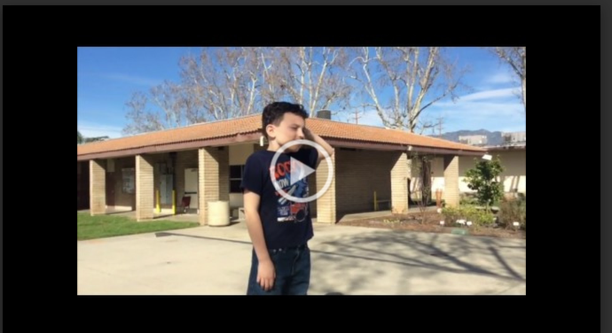
Video - Depth & Complexity with 1st grade Students
https://drive.google.com/file/d/1Npkuj9rMQuTSENSv6_zp3iYW4h4N-5uk/view?ts=64e03775
Notes:
Tami- here are some 1st graders views on the Icons of Depth and Complexity.

Slide 31
Here’s an example of what we used in my class…

Slide 32
Spiraling from “Simple to Complex”
-with Mr. Bui

Slide 33
Simple to Complex
Concrete to Abstract
Closed to open
2+2 1+2 5+5
Why is “adding” a powerful skill to have?

Slide 34
Dad, is that a dog?
Your child sees a dog for the first time and then everything with 4 legs and a tail becomes a dog.
This is your child’s brain going from simple to complex.
What is dog?
Complex thinking means abstract thinking
Abstract thinking means thinking about ideas that are not immediately clear

Slide 35
Simple to Comlex at home
Three Little Pigs
-What lesson did you learn from the 3 little pigs?
-Is there another story that shares a similar theme?
-What can the story of the Three Little Pigs teach us about maturity?

Slide 36
Rigor in Math
Big Idea: Everything is connected in some way. In other words: ________________________________________________.
WOD: Ratio (Ray-she-Oh) Ratios show how two quantities (things/numbers) are connected and they are EVERYWHERE. You already know a lot of ratios. 60 seconds to 1 minute 60 minutes to 1 ______ 24 hours to 1 ______ 365 days to 1 ______ 100 years to 1 century
How to Write a Ratio David’s mom said that for every 4 hours he reads per week, he can play games for 1 hour. We can write this ratio using “to” just a colon. 4 hours of reading to 1 hour of games 4 hours of reading : 1 hours of game 4 : 1 or 4 to 1
Ratios and Our Class: (Do together) Find the ratio of boys to girls in our class: ____ to ___, _____:_____ Find the ratio of girls to bos in our class: ____ to ___ _____:_____ Take the quiz below to discover some ratios about our classmates. Did you travel this summer?: Yes or No Ratio: _________ You are an only child: Yes or No Ratio: _________ You love spaghetti: Yes or No Ratio: _________ You can swim well: Yes or No Ratio: _________
How do ratios show that everything is connected in some way? _______________________________________________________________ _______________________________________________________________

Slide 37
Rigor in ELA
Entertain: What does cool mean to you? Tell us about an experience you’ve had with trying to be cool or wanting to be cool.
Who was there?
Where and when did this story take place?
How did you react?
What happened afterwards
Entertain: Fact or Fiction: Write a 40 second story about a time you choked under pressure. Add details like:
Who was there?
Where and when did this story take place?
How did you react?
What happened afterwards?
Dialogue

Slide 38
Rigor in ELA
Persuade: Imagine that you were on the branch next to Rey before his “macho” jump to be cool. How would you persuade him to change his mind? Complete the prompt below and give Rey 2 good reasons to not jump.
“Rey, I think you should reconsider because
Persuade: Imagine that your friend had choked during a tournament and they are feeling really down on themselves. Write a 30 second speech and convince them that choking under pressure is not “the end of the world”. Mention a story from the article to support your point.

Slide 39
Rigor in Science
Knowing what you learned so far, do farts spread faster in a hot room or a cold room? Explain how the video from the previous slide and our lab supports your claim. Make sure you accurately use the language of the discipline so you can sound like an expert: random motion, diffusion, kinetic energy.
According to my research, farts spread

Slide 40
Takeaways for Parents
- Rigor doesn’t always have to mean MORE
-Rigor could also mean novel
-Rigor could also mean “honing”
-Rigor could also mean “real world” application
-What do you do with your abstract thinkers?
-We have systems in place at Edison to modify rigor to best meet your child’s needs.

Slide 41
Election - Edison Parent Gate Representative
Represent Edison at the District Level GATE meeting:
District GATE PAC Meetings 3:00pm - 4:00pm
Wednesday, August 23, 2023
Wednesday, February 7, 2024
Wednesday, April 3, 2024 -
Parent representative from PAC is asked to present information from the district PAC at site meetings.
Online - Self nominate by putting your name in the chat or sending a private chat message to host.
PLEASE VOTE NOW

